Slide 1

Azure Arc Enterprise Architecture
& Bandwidth Analysis (2,000 Servers)
Extending Azure Control Plane, Governance, Security, Monitoring, and Patch Management across heterogeneous on-premises Windows, Linux, SQL Server, and Oracle workloads.

Slide 2
Executive Summary & Scope
Architectural blueprint for unifying operations and compliance across 2,000 hybrid servers.

Slide 3



Executive Summary & Business Value
Control Plane Extension
Unified Security & Patching
Operational Efficiency
Brings Azure Resource Manager (ARM), Azure Policy, and RBAC to on-premises data centers, treating non-Azure servers as native Azure resources.
Standardizes posture assessment via Microsoft Defender for Cloud and automated patching through Azure Update Manager across the entire estate.
Eliminates siloed tooling by centralizing telemetry into Azure Monitor Workspaces while maintaining enterprise ITSM/SIEM integrations.

Slide 4


Operational Transformation: Before vs. After Azure Arc
Before Azure Arc (Siloed Ops)
After Azure Arc (Unified Control)
Fragmented patching routines across disparate Windows/Linux scripts.
Centralized maintenance windows via Azure Update Manager.
Single pane of glass for telemetry via Azure Monitor & Log Analytics.
Disconnected monitoring agents and manual compliance reporting.
Automated configuration governance enforced through Azure Policy.
Lack of centralized RBAC or automated policy drift remediation.
Comprehensive asset intelligence queryable via Azure Resource Graph.
High operational overhead managing multi-cloud & on-prem inventories.

Slide 5

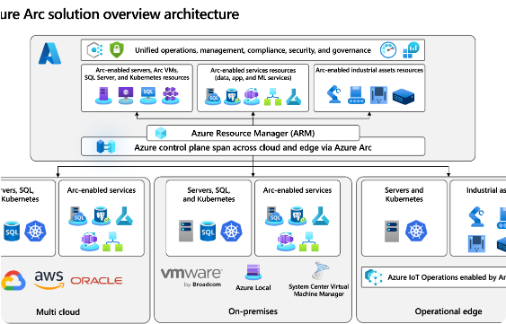
Azure Arc Operating Model & Architecture
The Azure Connected Machine Agent runs locally on Windows and Linux servers, establishing a secure, outbound-only HTTPS connection to the Azure control plane.
Control Plane: Azure Resource Manager treats machines as first-class ARM resources.
Identity: Managed identities securely authenticate against Microsoft Entra ID.
Scope Separation: Application data traffic does not traverse Azure; only management, policy, and monitoring telemetry flow.

Slide 6


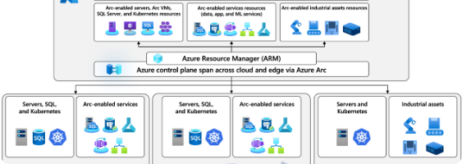
Detailed Hybrid Connectivity Architecture
On-Premises Datacenter Zones
Azure Management Plane
Servers (Windows, Linux, SQL, Oracle, VMware) reside in secure zones. Communication to Azure is mediated via internal firewalls, optional proxy/relay servers in the DMZ, and corporate ExpressRoute circuits or encrypted HTTPS Internet paths.
Incoming management requests are processed by Azure Resource Manager, distributed to Log Analytics Workspaces, evaluated by Azure Policy, and secured via Microsoft Defender for Cloud and Entra ID.

Slide 7
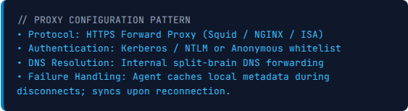
Enterprise Relay & Proxy Server Architecture
When direct outbound Internet connectivity is restricted by security policy, enterprise-grade forward proxy or Azure Arc Private Link Scope (AMPLS) / Relay servers must be deployed in the DMZ.
High Availability: N+1 load-balanced proxy pool deployed behind internal hardware load balancers.
Traffic Inspection: SSL/TLS termination and inspection rules applied at perimeter firewalls.

Slide 8
Azure Arc Firewall & Network Whitelist Matrix
Endpoint Category / FQDN | Port | Direction | Purpose | Proxy Support
*.management.azure.com | 443 | Outbound | Azure Resource Manager API communications | Yes
*.azure-automation.net | 443 | Outbound | Hybrid Runbook Worker & Update Manager | Yes
*.ods.opinsights.azure.com | 443 | Outbound | Log Analytics data ingestion (AMA / MMA) | Yes
*.login.microsoftonline.com | 443 | Outbound | Microsoft Entra ID token acquisition | Yes

Slide 9
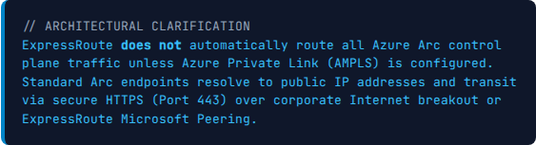
ExpressRoute Architecture & Hybrid Routing
Enterprise ExpressRoute circuits provide high-speed, reliable private connectivity between on-premises datacenters and Azure VNets.
Private Peering: Used for internal Azure VM workloads and private endpoints.
Microsoft Peering / Internet: Azure Arc management endpoints (`*.management.azure.com`) operate via HTTPS over public IPs or Azure Private Link Scopes (AMPLS).

Slide 10

Azure Arc Capability: Centralized Server Inventory
Transforms scattered physical and virtual servers into queryable Azure resources.
Resource Graph: Execute KQL queries across 2,000 servers instantly.
Metadata Tagging: Enforce cost center, environment, and owner tags uniformly.
OS & Hardware: Real-time discovery of kernel versions, CPU specs, and IP configs.

Slide 11
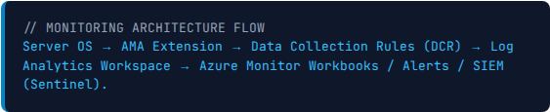
Azure Arc Capability: Unified Azure Monitor
The Azure Monitor Agent (AMA), installed via Azure Arc extension framework, streams OS metrics and logs directly to centralized Log Analytics Workspaces.
Data Collection Rules (DCR): Granular filtering to control exact log payloads.
Performance & Events: CPU, RAM, Disk I/O, Windows Event Logs, and Linux Syslog.

Slide 12
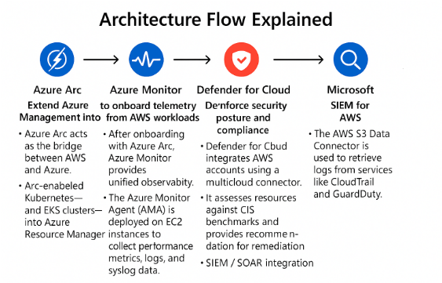
Azure Arc Capability: Azure Update Manager
Automates assessment and deployment of software updates across hybrid Windows and Linux servers from a single dashboard.
Maintenance Windows: Scheduled recurring patching windows with pre/post scripts.
Dynamic Scoping: Automatically target servers based on Azure Resource tags.
Compliance Reports: Instant auditing of missing security and critical patches.

Slide 13
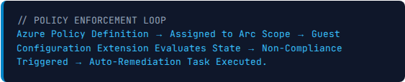
Azure Arc Capability: Azure Policy & Governance
Extends cloud governance principles directly to on-premises infrastructure.
Configuration Auditing: Check if required security agents or registry settings are present.
Automatic Remediation: Deploy missing extensions or settings automatically upon drift detection.

Slide 14
Azure Arc Capability: Microsoft Defender for Cloud
Provides advanced threat protection and vulnerability assessment for non-Azure servers.
Vulnerability Assessment: Integrated scanning for OS and software flaws.
Threat Detection: Behavioral analytics alerting on unauthorized process execution or brute-force attempts.

Slide 15
Security & Regulatory Compliance Alignment
Regulatory Standards
Zero Trust Identity
Encryption in Transit
Supports compliance mapping for CIS Benchmarks, NIST SP 800-53, ISO 27001, and PCI DSS via built-in Azure Policy regulatory initiatives.
Leverages Microsoft Entra ID and RBAC to enforce strict least-privilege administrative access across all hybrid server resources.
All communications between the Azure Connected Machine Agent and Azure control plane are encrypted using TLS 1.2+.

Slide 16
Enterprise Tool Coexistence & Integration
Domain | Existing Tool | Azure Arc Capability | Recommended System of Record
Infrastructure Monitoring | SolarWinds | Azure Monitor / AMA | Coexistence (SolarWinds for network/legacy; Azure Monitor for cloud-native)
Log Management | Splunk | Log Analytics Workspace | Splunk (via Azure Event Hub streaming)
ITSM / Ticketing | ServiceNow | Azure Automation Webhooks | ServiceNow (Master CMDB & Incident Management)
Database Monitoring | Oracle OEM | Azure Arc SQL/Oracle Ext. | Oracle OEM for deep DBA tuning; Azure Arc for inventory/policy

Slide 17



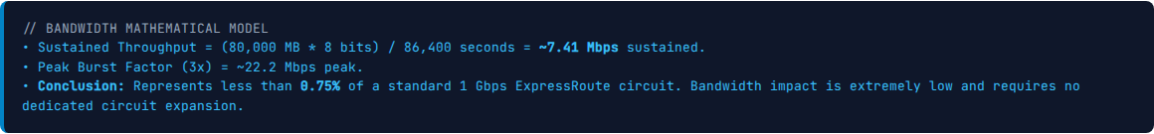
2,000-Server Bandwidth Calculation Model
2,000
40 MB
80 GB / day
Total Servers
Daily Payload / Server
Aggregate Volume
Mixed Windows, Linux, SQL, and Oracle workloads.
Combined heartbeat, inventory, metrics, and policy audits.
Total data transmitted daily across all 2,000 instances.

Slide 18
ExpressRoute Sizing & Traffic Segregation
When sizing enterprise circuits, network architects must separate application data traffic from Azure Arc management & telemetry traffic.
Deployment Tier | Avg Mbps | Recommended Circuit
Minimal (Inventory + Policy) | ~2 Mbps | 50 - 100 Mbps
Typical (Arc + AMA + Update) | ~7.4 Mbps | 100 - 500 Mbps
High (Full Logs + Defender) | ~25 Mbps | 500 Mbps - 1 Gbps
App/Data Traffic: Varies heavily by database replication, file shares, and user requests (High Bandwidth).
Arc Telemetry: Highly predictable, low-volume background heartbeat and log stream (~7.4 Mbps for 2,000 servers).

Slide 19



Bandwidth Optimization & Telemetry Tuning
Data Collection Rules (DCR)
Polling Interval Tuning
Proxy Caching
Filter out noisy Windows Event IDs or debug-level syslog entries at the source before transmission to conserve bandwidth.
Adjust performance counter collection frequencies from 10 seconds to 60 seconds for non-critical development and test environments.
Deploy local proxy caching servers for software update binaries to prevent repetitive downloads across WAN links.

Slide 20
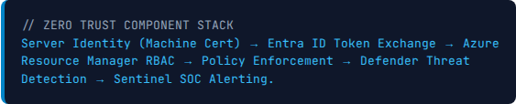
Security Architecture & Zero Trust Alignment
Adheres to strict Zero Trust principles across identity, device posture, and network communication layers.
Managed Identities: System-assigned managed identities eliminate stored credentials.
Least Privilege RBAC: Granular Azure roles restrict who can execute remote commands or patch tasks.
TLS Encryption: All control plane traffic secured via TLS 1.2+ end-to-end.

Slide 21
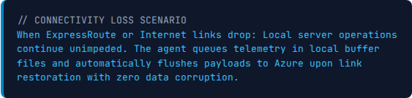
High Availability & Offline Agent Resilience
Enterprise workloads require robust resilience against network partitions or Azure service outages.
Local Caching: The Azure Connected Machine Agent caches inventory, configuration, and status locally if connectivity is lost.
Autonomous Execution: Scheduled patching or local scripts execute independently of Azure cloud connectivity.

Slide 22
2,000-Server Phased Rollout Roadmap
Phase 0: Assessment
Phase 1: Pilot
Phase 2-5: Waves
Weeks 1–4: Firewall rule validation, proxy setup, and automated discovery scan across 2,000 targets.
Weeks 5–8: Onboard 50 pilot servers (mix of non-prod Windows & Linux) to validate telemetry and patch workflows.
Weeks 9–24: Systematic rollout in waves of 500 servers (Waves 1 to 3) until full 2,000 estate is onboarded.

Slide 23
Operational RACI Matrix
Operational Function | Cloud Ops | Security (CISO) | Platform / OS | Network
Arc Agent Deployment & Lifecycle | Responsible | Accountable | Consulted | Informed
Azure Policy & Compliance Definition | Accountable | Responsible | Consulted | Informed
Patch Management & Update Windows | Responsible | Consulted | Accountable | Informed
Firewall & ExpressRoute Connectivity | Informed | Consulted | Informed | Responsible

Slide 24


Cost Considerations & Licensing Structure
Included in Azure Arc Base
Consumption Services (Add-ons)
Azure Resource Manager (ARM) control plane integration.
Log Analytics / AMA: Ingestion and retention charges per GB.
Azure Policy guest configuration auditing.
Defender for Cloud: Per-server security workload protection fee.
Basic inventory and tagging management.
Update Manager: Management fee per active Arc-enabled server.

Slide 25



KPIs & Business Value Model (2,000 Servers)
100%
>95%
65%
Inventory Visibility
Patch Compliance
Effort Reduction
Complete asset discovery across hybrid estate.
Automated monthly security update adherence.
Decrease in manual audit and report preparation hours.

Slide 26
Questions & Answers
Thank you for your time. Open discussion on architecture, rollout waves, and next steps.
Enterprise Cloud Architecture & Engineering Team

Slide 27


Image Sources
https://learn.microsoft.com/en-us/azure/azure-arc/media/overview/azure-arc-control-plane.png
Source: learn.microsoft.com
https://blog.thevtg.com/hs-fs/hubfs/AWS%20ARC.png?width=1536&height=1024&name=AWS%20ARC.png
Source: blog.thevtg.com

